Slide 1



Blockchain base
Crypto currency
platform
Blockchain is a technology that keeps a record of transactions on many computers at the same time.
These records, called blocks, are connected like a chain, making it secure and hard to change and Cryptocurrency is a type of digital money that uses blockchain technology to work.

Slide 2


About
Us
Al-Amin Islam – Project Coordinator
Oversees project planning, execution, and team coordination to ensure timely delivery.
2. Md Alvi Hasan Emon – UI/UX Frontend Developer
Designs and implements the visual and interactive elements of a website or application.
Tahmid Hasan Rafi –Backend Developer
Develops and maintains server-side logic, APIs, and database interactions.
Tanha Zaman – Database Developer
Creates, optimizes, and manages databases for efficient data storage and retrieval.
Abida Hossain Shrabonti - Quality Assurance
Tests and ensures software meets quality standards and is free of defects.

Slide 3

What is
Cryptocurrency?
Cryptocurrency is a type of digital or virtual currency that uses cryptography for security. It operates on a decentralized network, typically based on *blockchain technology*, which is a distributed ledger enforced by a network of computers . Unlike traditional currencies issued and regulated by governments or central banks, cryptocurrencies are generally decentralized and operate independently of any central authority.

Slide 4
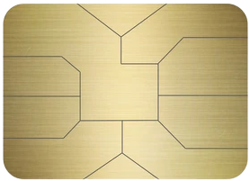
RAT CRYPTO
FUNCTIONALITIES
Step-1
Step-3
Admin Dashboard Title: Indicates the user is viewing an admin interface.
User Profile: Displays the user's profile picture and name, with a dropdown for profile-related options.
"Multi-Wallets" with icons for different cryptocurrency wallets, including Trust, MetaMask, Tron, and Binance Smart Chain.
Step -2
Exchange: Possibly for currency exchange options. Crypto Exchange page that allows users to convert one cryptocurrency to another or to a fiat currency.
From: Select the cryptocurrency or fiat currency to convert from
To: Select the target currency for the conversion
Amount Field: Input field to enter the amount of currency to exchange.
Exchange Now Button: A button to execute the currency exchange.

Slide 5
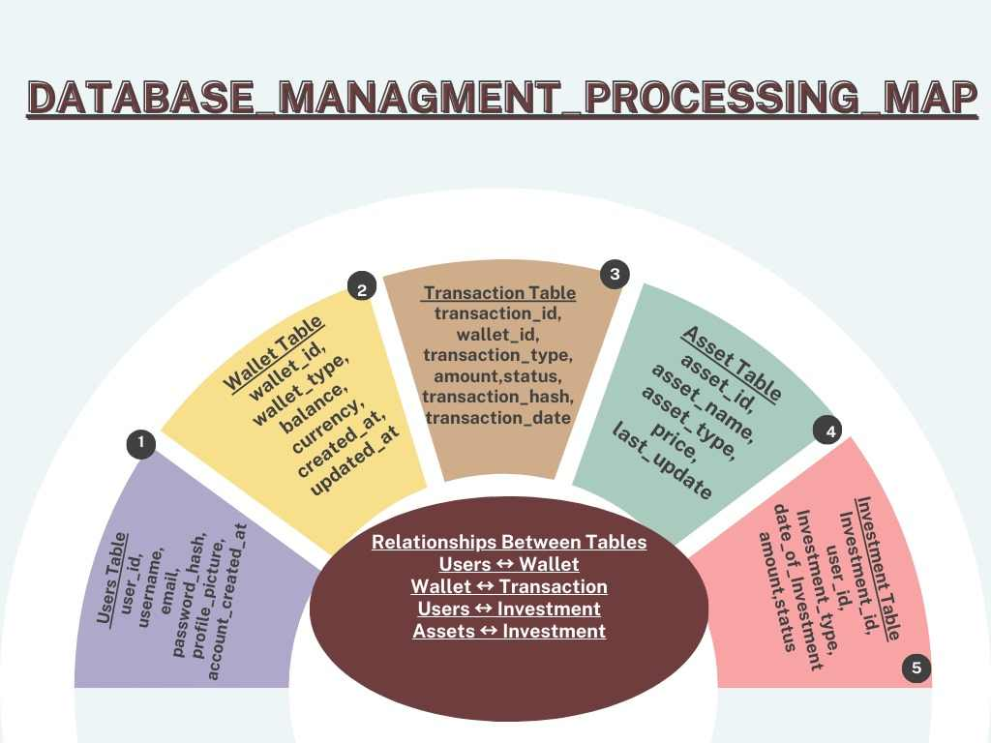
Key SQL Insights
Admins: Platform management.
Blocks: Blockchain data.
Users: Links wallets & help queries.
Transactions: Logs all transfers.
Active Users: Growth trends.
Transaction Volume: High-level stats.
Pending Queries: Unresolved tickets.

Slide 6
Advantages of PoC
Proof of Capacity (PoC) mining, also known as Burstcoin mining, has several advantages compared to traditional mining mechanisms like Proof of Work (PoW) or Proof of Stake (PoS).
Here are the main advantage :
1. Energy Efficiency
2. Lower Hardware Requirements
3.Eco-Friendly
4.Increased Accessibility
5.Low Entry Barrier
**Why use PoC mining ??
Proof of Capacity (PoC) mining is a highly suitable method for those seeking a sustainable, cost-effective, and accessible approach to blockchain mining. Unlike energy-intensive methods like Proof of Work (PoW), PoC relies on utilizing hard drive storage space rather than high-powered GPUs or ASICs. This makes it significantly more energy-efficient, eco-friendly, and affordable. The low cost of entry, as standard hard drives are widely available and inexpensive, allows individuals with minimal technical expertise to participate. Furthermore, PoC mining promotes decentralization by enabling more users to contribute to the network without relying on expensive setups, reducing the dominance of large-scale mining farms.

Slide 7
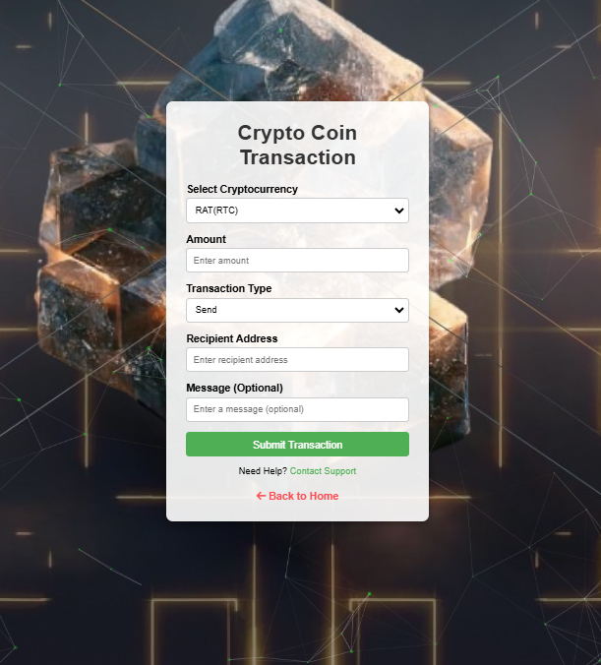
Transaction
Process
"Crypto Coin Transaction" form where users can select a cryptocurrency, enter the amount, choose a transaction type (send), input the recipient's address, and optionally include a message. Users can submit the transaction or seek help through the provided contact support link.
“RatCoin wallet” interface displaying the user's balance, seed phrase, and multiple addresses. It provides options to mine RatCoin, send RatCoin by entering a recipient address, and view transaction history.

Slide 8
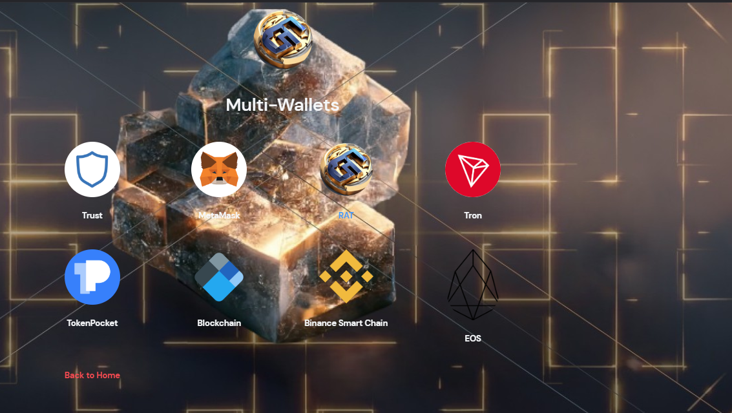

Exchange Features
Seamless Crypto Swaps:
Exchange any crypto to BTC, Ethereum, USDT, andmore.
Multiple Wallet Integration:
Supports Trust Wallet, MetaMask, Binance Wallet, and others.
Real-Time Conversion:
Live rates ensure accurate and transparent exchanges.
User-Friendly Interface:
Simplified process for quick and secure transactions.

Slide 9
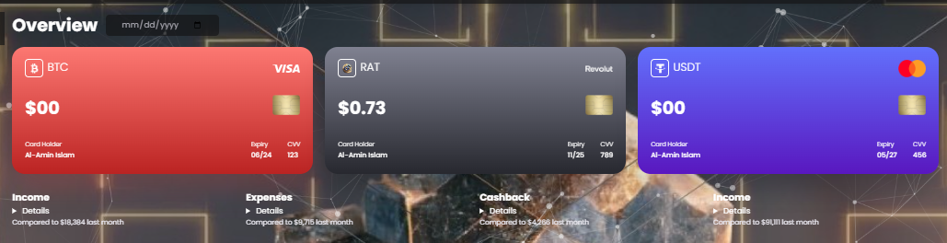
RAT Facilities
Benefit 01
Benefit 02
Benefit 03
01
*Financial Inclusion*
Cryptocurrencies provide access to financial services for people without access to traditional banking, especially in underserved regions.
02
*Transparency and Security*
Transactions are recorded on a blockchain, a public ledger that is tamper-proof and transparent, ensuring secure and traceable operations.
03
*Privacy and Anonymity*
Many cryptocurrencies offer enhanced privacy features, allowing users to conduct transactions without revealing personal information.

Slide 10
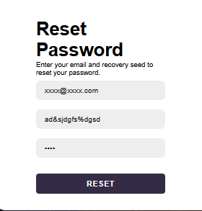
Enhanced Security Measures
II Seed Features for Password Recovery:
What: Utilization of unique seed phrases to recover passwords.
Why: Ensures users can securely regain access to their accounts without compromising security.
How: Randomly generated phrases stored securely using encryption.
II Default Hash Codes for Transactions:
What: Auto-generated hash codes for sending and receiving cryptocurrency.
Why: Provides an extra layer of protection and ensures integrity in transactions.
How: Cryptographic hash algorithms (e.g., SHA-256) are employed.

Slide 11
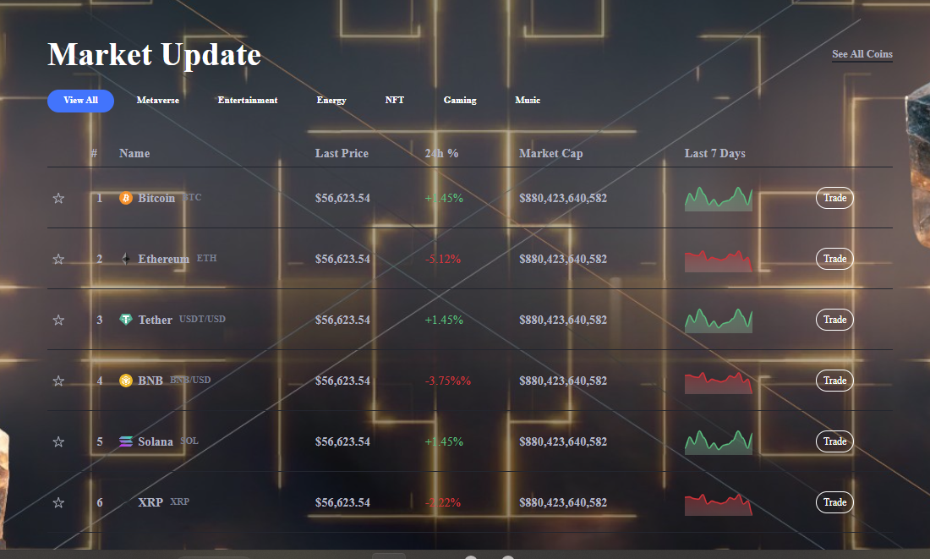
Future of
Cryptocurrency
It's important to note that cryptocurrency markets are highly volatile, and such predictions should be approached with caution. Conduct thorough research and consider your financial situation before making any investment decisions.

Slide 12
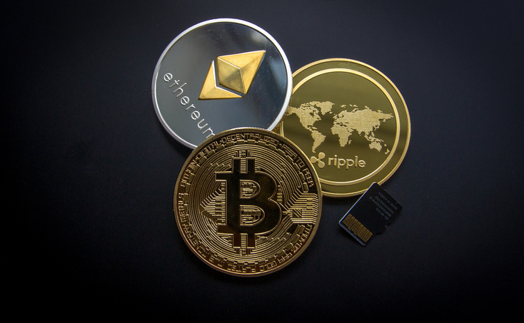


Thank You

